Slide 1
Collaborative Platform Version 6.0
Team Members
Mandiel Lastra (Developer)
Michael Machin (Developer)

Slide 2
Problem
Current students lack a reliable source for answering questions related to their classes or projects in a timely manner.
Students may rely on several sources, often unreliable, inaccurate, and incomplete.
There exists a difficulty matching the right subject matter expert to the right question
Professionals in the field lack an accessible way of being able to mentor students.

Slide 3
Problem
Solution
Synchronization issue when users join a videoconference
Difficult interaction with the system
Lack of basic functionalities
Ability of users joining a conference after it has started
Improve usability of the system
Provide users with new features.

Slide 4
Implemented User Stories
Allow users to turn their webcam on/off
Bug: Allow for users to register
Bug: Allow users to reset their password using the ‘Forgot Password’ option
Allow users registered by an administrator to change their password
Allow users to edit a video conference’s information
Allow users to join a conference without synchronization problems
Provide users with a second screen sharing window
Allow users to have a robust video conference room
Provide users with a chat feature
Allow users to join a conference and receive both screens if shared
Allow users to invite others by name when creating or editing a conference
Allow users to access Past/Canceled Video Conferences
Improve usability of the system

Slide 5
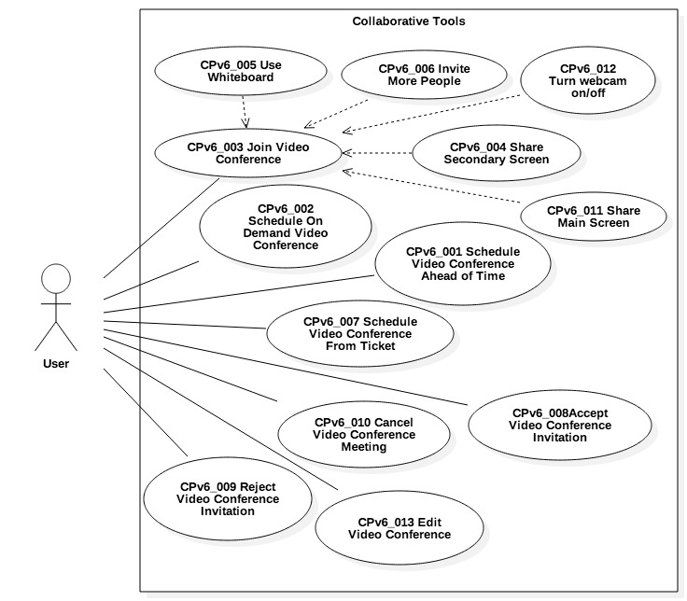
Use Cases

Slide 6
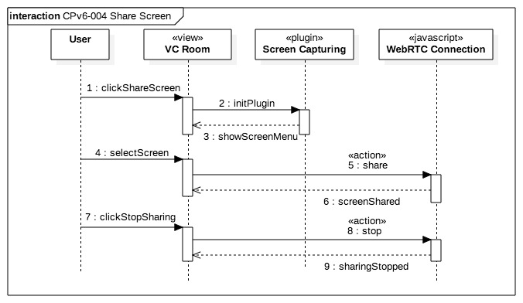
Sequence Diagrams

Slide 7
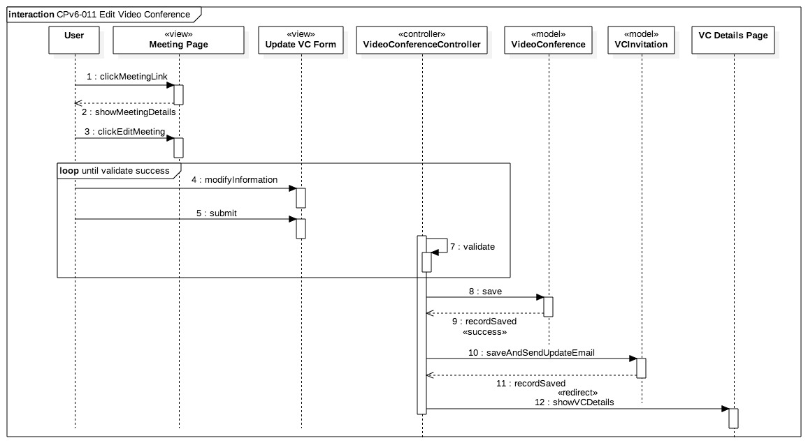
Sequence Diagrams

Slide 8
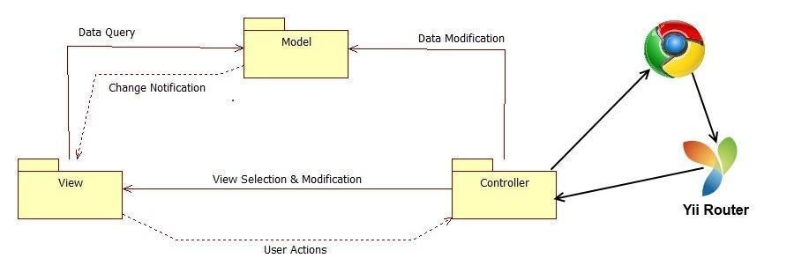
System Decomposition

Slide 9
System Deployment
Minimum Hardware
Minimum Software
Processor | 1.6 GHz
RAM | 256 MB
CPU op-model(s) | 32-bit
Database Server | MySql 5.5
Web Server | Apache 2.0
Server-side Scripting | PHP 5.5
Operating System | Windows, Linux, Mac OS

Slide 10
Security/Privacy
Yii access control rules
Yii Cross-site scripting prevention
Password hashing
Secure registration process

Slide 11
Share Both Screens algorithm
User1:
Click on
‘Screen Sharing’->‘Share Screen’
2. Select screen to be shared
3. if(!rightScreenIsShared){
sendStreamIdToAllUsers();
shareScreenOnTheRight();
}
else {
shareSceenOnTheLeft();
}
User2:
Click on
‘Screen Sharing’->‘Share Screen’
2. Select screen to be shared
3. if(!rightScreenIsShared){
sendStreamIdToAllUsers();
shareScreenOnTheRight();
}
else {
shareSceenOnTheLeft();
}

Slide 12
Test Cases
Test Case ID | TC_CP_VCM_02 Video conference is edited
Test Objective | Test that a conference can be edited by the moderator
Precondition | 1. User is logged into the Collaborative Platform site. 2. User is on the "Video Conference" page or the "View Video Conference" page. 3. User has a video conference that was created by him/her
Steps: | 1. Click on "Edit" on the conference to be editted 2. Make necessary changes 3. Click on "Save"
Test Data | Subject: Integration Testing Date: 08/05/2015 Time: 11:00 am Invitee: Lastra, Mandiel Invitee 2: Machin, Michael
Expected Result | The invitations have been sent successfully sent
Actual Output | The invitations have been sent successfully sent
Test Case ID | TC_CP_VCM_02 Video conference invitation to user that is not registered
Test Objective | Test that an invitation cannot be sent to a user that is not registered in our system
Precondition | 1. User is logged into the Collaborative Platform site. 2. User is on the "Video Conference" page or the "View Video Conference" page. 3. User has a video conference that was created by him/her
Steps: | 1. Click on "Edit" on the conference to be editted 2. Make necessary changes 3. Click on "Save"
Test Data | Subject: Integration Testing Date: 08/05/2015 Time: 11:00 am Invitee: Smith, John
Expected Result | Smith, John does not appear in our records
Actual Output | Smith, John does not appear in our records

